Slide 1
Recursive & Iterative Algorithms

Slide 2
Recursive Algorithms
A recursive algorithm is one that calls itself during implementation.
Recursive algorithms require two cases, a recursive case and a base case, in order to function properly (and ultimately end).
Recursive functions generally require a large amount of storage space to stack the operations it is going to do once it reaches the base case
Notes:
Presentation order:
Functions calling other functions (what order of characters are displayed)
A stack ADT for keeping track of return addresses
Functions calling itself (stack overflow)
Write a factorial function (iterative)
Write a factorial function (recursive)
Base case is IMPORTANT
Exercise: write a skip_sum for even numbers: 2 + 4 + 6 + 8 + 10 + ...
Exercise: extend skip_sum for odd numbers: 1 + 3 + 5 + 7 + 9 + …
2x base cases

Slide 3
Iterative Algorithms
Iterative algorithms repeat the same process a given number of times or until reaching a termination condition.
Iterative algorithms generally don’t require much storage space and so are more favourable for many processes.

Slide 4
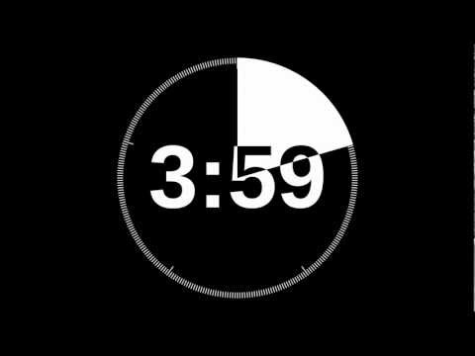
Example - finding the factorial of x

Slide 5
Example - finding the factorial of x
Recursive
Define a function: Factorial (x)
If x>1
return x * Factorial (x-1)
If x=1
return 1
Iterative
Define a function: Factorial (x)
set Total = 1
For every integer number, i, between 1 and x:
Set Total = i * Total
return Total

Slide 6
Quickly…. Find the sum of all the numbers from 1 to 100

Slide 7
Quickly…. Find the sum of all the numbers from 1 to 100
Write the iterative version
Now write a recursive function to calculate the sum of all the numbers from 1 to n

Slide 8

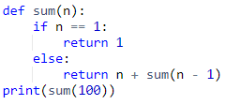
Quickly…. Find the sum of all the numbers from 1 to 100
Write the iterative version
Now write a recursive function to calculate the sum of all the numbers from 1 to n

Slide 9
Find minimum integer element in a list of integers
Write the iterative version
Now write a recursive function to find the minimum

Slide 10
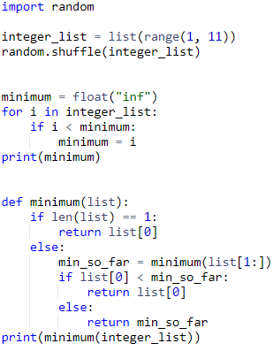
Find minimum integer element in a list of integers
Write the iterative version
Now write a recursive function to find the minimum

Slide 11
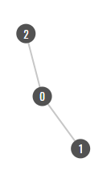
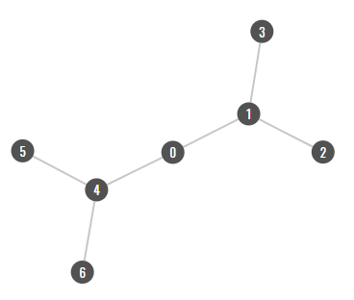
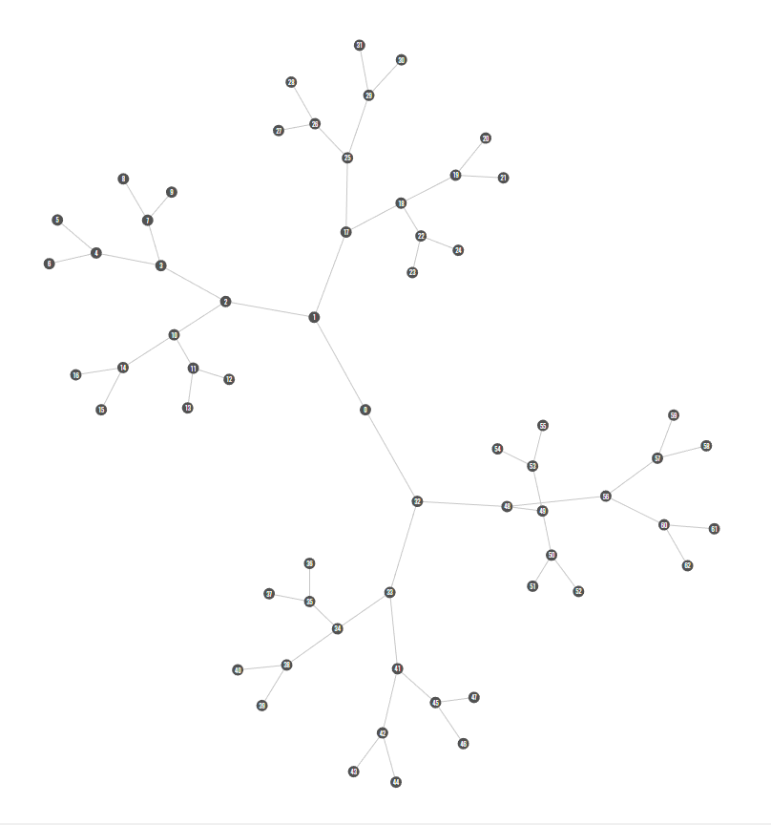
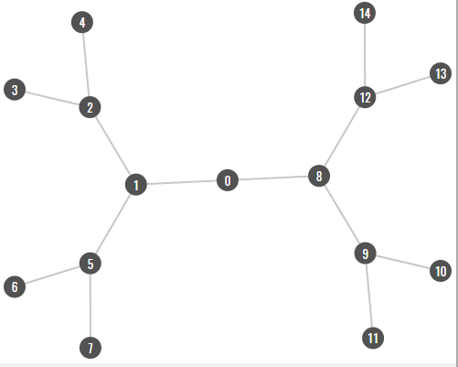
Write a recursive function to generate these graphs in PyNode

Slide 12
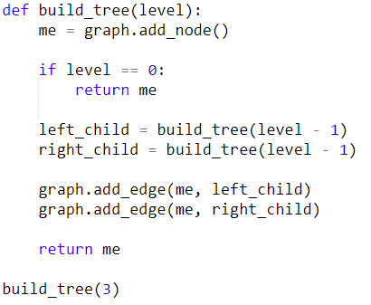
Write a recursive function to generate these graphs in PyNode

Slide 13
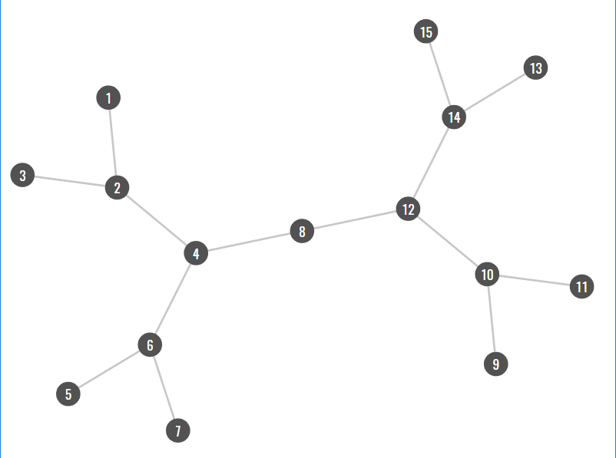
Write recursive functions to generate this graph in PyNode - Notice the node IDs in this graph

Slide 14
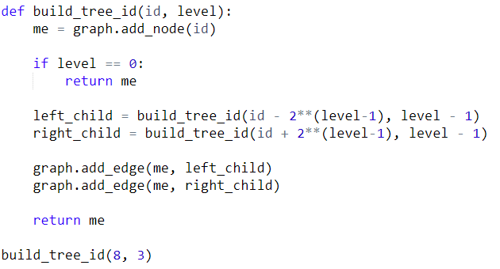
Write recursive functions to generate this graph in PyNode - Notice the node IDs in this graph

